Slide 1


<Jorlina Panoti>
<03/18/2023>

Slide 2

Outline
Executive Summary
Introduction
Methodology
Results
Conclusion

Slide 3
Executive Summary
Methodologies
Data were collected by Space X API (get request) and Wikipedia (Web scraping)
Eda Analysis is done using SQL, Visualization using Pandas, Matplotlib, Interactive visual Analytics(Folium and Plotly dashboard).
Machine Learning for building models.
Summary of Results
The success rate of the Falcon 9 rocket launches is associated with the launch sites, payload mass, orbit type and year of launch.
Visualization were great for decision making
We gained the optimal model using the decision tree.

Slide 4
Introduction
Project background and context
The purpose is to predict if the Falcon 9 rocket first stage will land successfully
The Falcon 9 rocket launches is estimated to be about 62 million dollars which is cheaper than other providers due to SpaceX ability to reuse the first stage
We will determine if the first stage will land, and this will help to determine the cost of the launches.
Problems you want to find answers
Will the rocket land successfully?
What factors are associated with the success rate of Falcon 9 rocket launches?
What is the accuracy of successful landing?

Slide 5
Methodology
Executive Summary
Data collection methodology:
Rest API (https://api.spacexdata.com/v4/launches/past)
Web scraping
Perform data wrangling
The data was transformed
Perform exploratory data analysis (EDA) using visualization and SQL
Perform interactive visual analytics using Folium and Plotly Dash
Perform predictive analysis using classification models

Slide 6
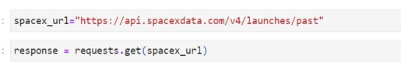
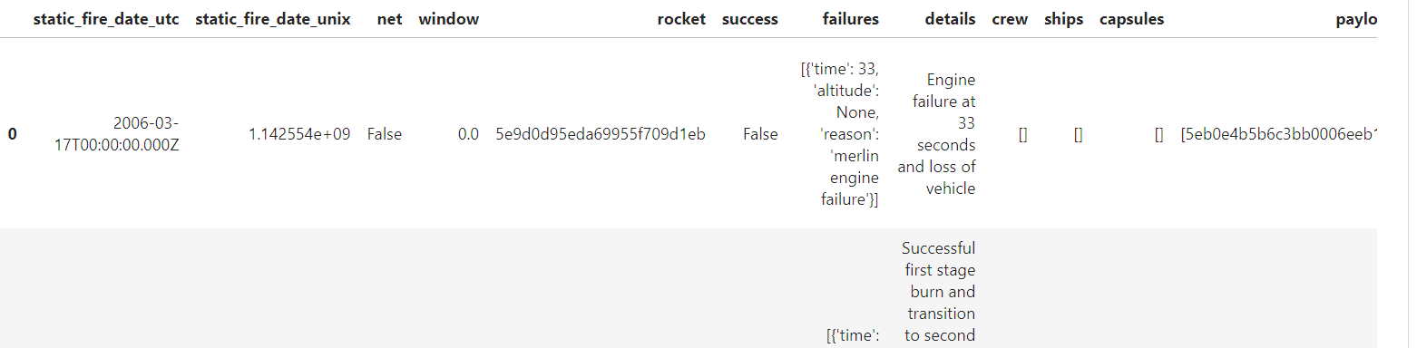
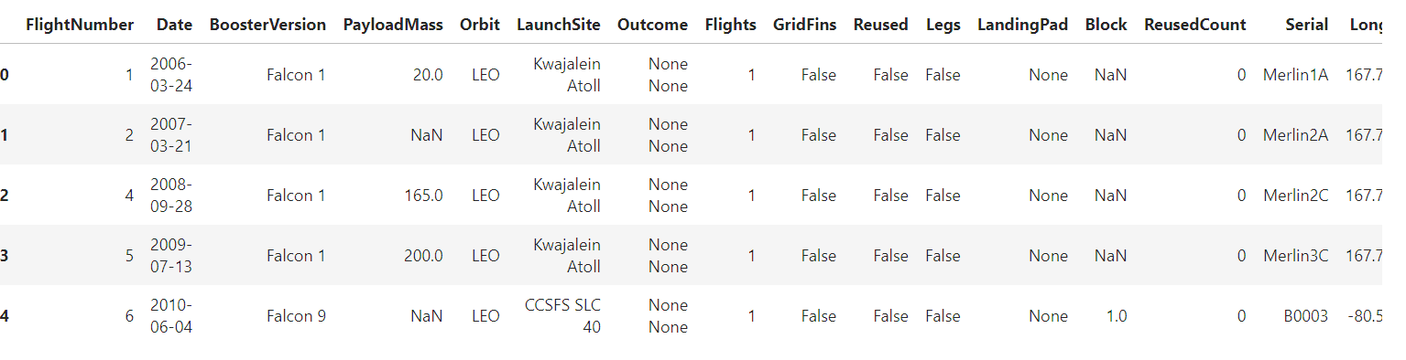
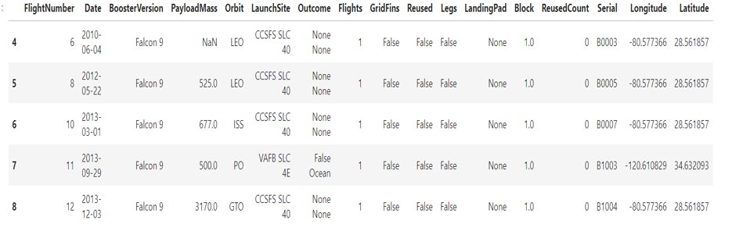
Data Collection- SpaceX API
SpaceX launch data is gathered from an API -The SpaceX REST.(https://api.spacexdata.com/v4/launches/past)
I collected data with an API Call
Converted to a data frame with JSON
Updating rows and columns
We kept only Falcon 9 Launches
Convert the data to a CSV file(data_falcon9.to_csv('dataset_part_1.csv', index=False))

Slide 7
Data Collection – SpaceX API
The GitHub URL of the completed SpaceX API calls notebook
(Applied-Data-Science-Capstone/data collection api.ipynb at main · Jorlina1/Applied-Data-Science-Capstone (github.com))

Slide 8
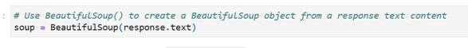
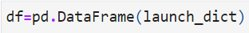
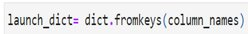
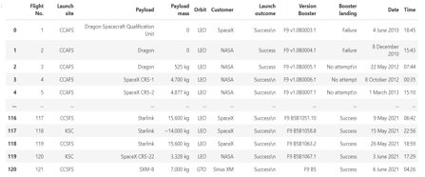
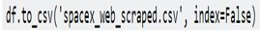
Data Collection - Scraping
Created a BeautifulSoup object from the HTML response
Extracted all column/variable names from the HTML table header
Created a data frame by parsing the launch HTML tables
1.Created an empty dictionary
2.Filled up the launch_dict with launch records extracted from table rows.
3.Converted it to a Pandas dataframe
4..Export it to a CSV file
Applied-Data-Science-Capstone/webscraping.ipynb at main · Jorlina1/Applied-Data-Science-Capstone (github.com)

Slide 9
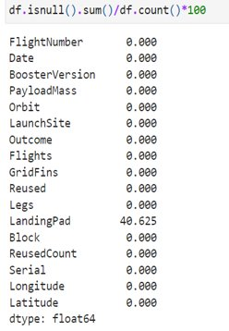
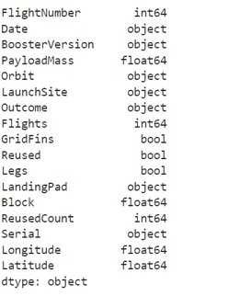
Data Wrangling
Identified numerical or categorical columns and calculated the percentage of the missing values.

Slide 10
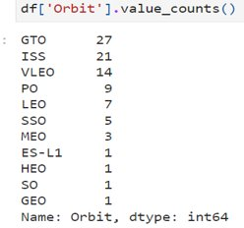
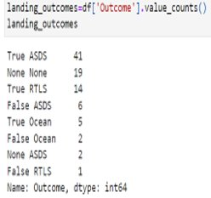
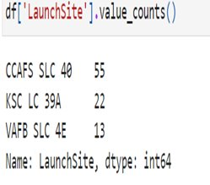
Data Wrangling
The number of launches on each site
The number and occurrence of each orbit
The number and occurrence of mission outcome per orbit type
Applied-Data-Science-Capstone/data wrangling eda.ipynb at main · Jorlina1/Applied-Data-Science-Capstone (github.com)

Slide 11
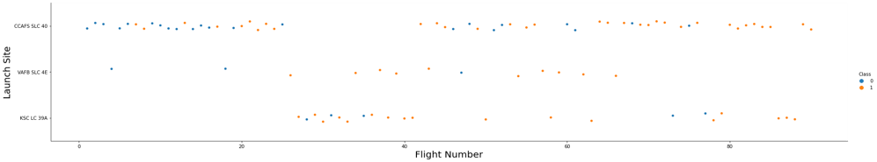
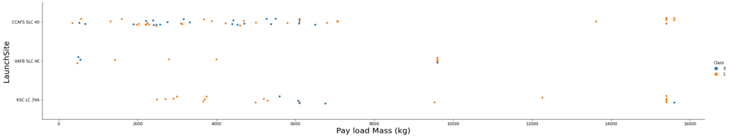
EDA with Data Visualization
The increase of Flight Number comes with the increase of success rate in launch sites
The increase of Pay load Mass comes with the increase of success rate in Launch Sites

Slide 12
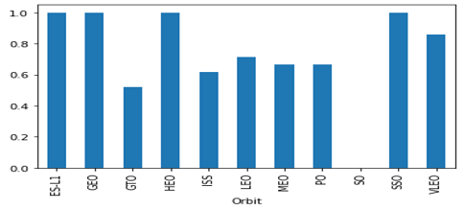
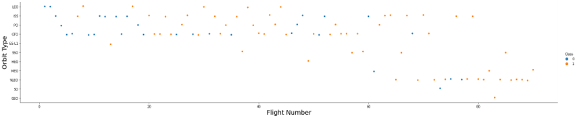
EDA with Data Visualization
The relationship between success rate of each orbit type.(SO has no success rate and ESL-1,GEO,HEO and SSO has a success rate of 100%)
No relationship between Flight Number and Orbit type

Slide 13
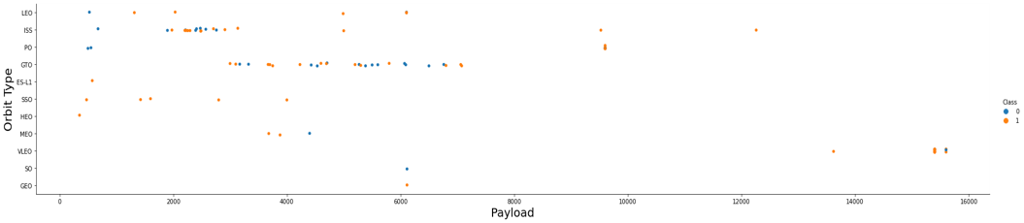
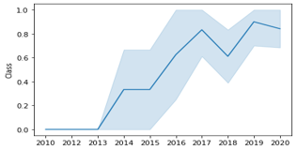
EDA with Data Visualization
The relationship between Payload and Orbit type
The launch success yearly trend (the success rate since 2013 kept increasing till 2020)

Slide 14
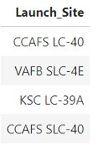
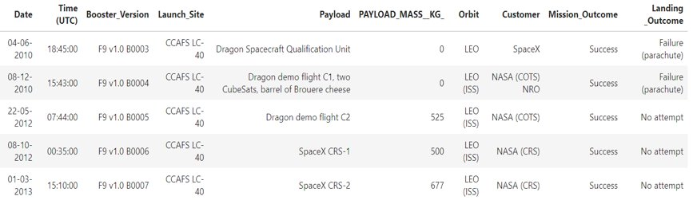
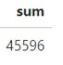
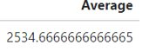
EDA with SQL
The names of the unique launch sites in the space mission
Display 5 records where launch sites begin with the string 'CCA'
The total payload mass carried by boosters launched by NASA (CRS)
Average payload mass carried by booster version F9 v1.1

Slide 15
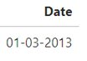
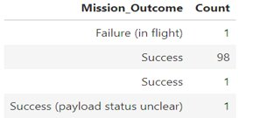
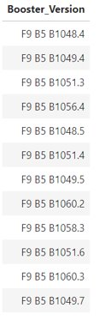
EDA with SQL
The date of the first successful landing outcome in ground
Total number of successful and failure mission outcomes
The booster_versions which have carried the maximum payload mass

Slide 16
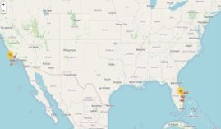
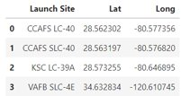
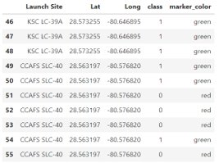
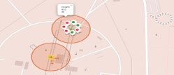

Build an Interactive Map with Folium
All launch sites on a map
folium.Circle and folium.Marker to create markers and circles above markers.
Mark the success/failed launches for each site on the map
folium.PolyLine object to draw PolyLine between a launch site to the selected coastline point
Launch sites are in close proximity to railways, to highways and to coastline.
Launch sites have significant distance from cities.
Closest distance of launch sites is to the city of Tutsville at about 0.9km.

Slide 17
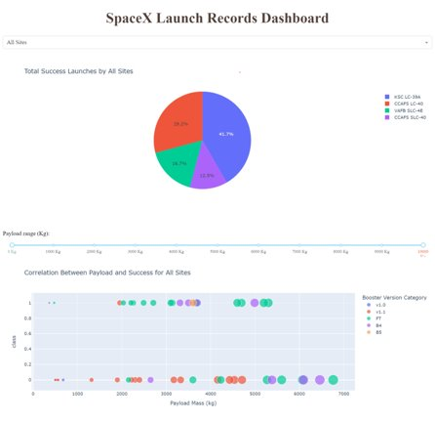
Dashboard with Plotly Dash
Added a launch site drop-down input component
Added a callback function to render the required success outcome pie chart
Added a range slider to choose payload
Added callback function to render the payload-outcome scatter plot

Slide 18
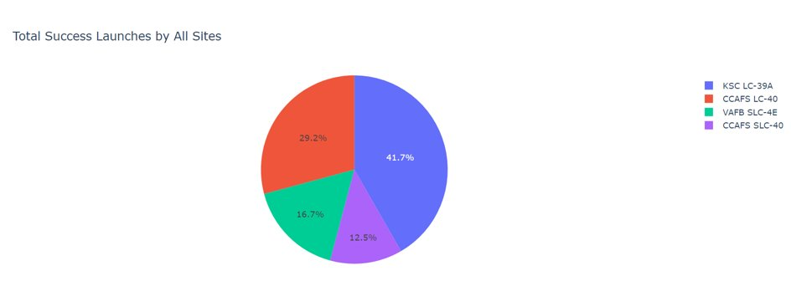
Dashboard with Plotly Dash

Slide 19
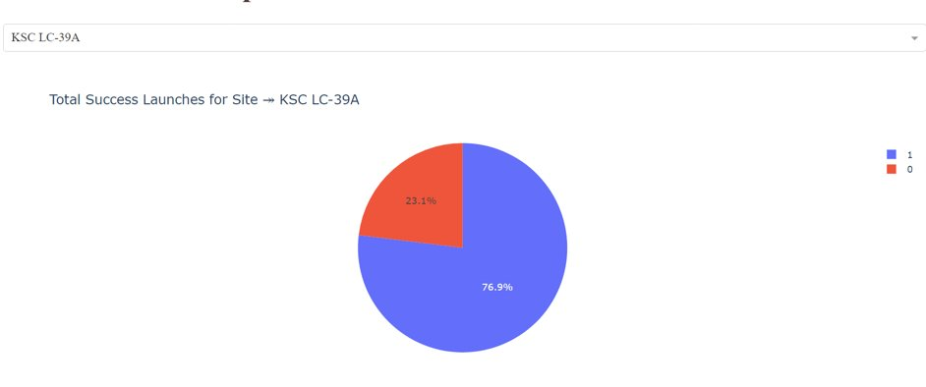
The Highest Launch Success Rate

Slide 20
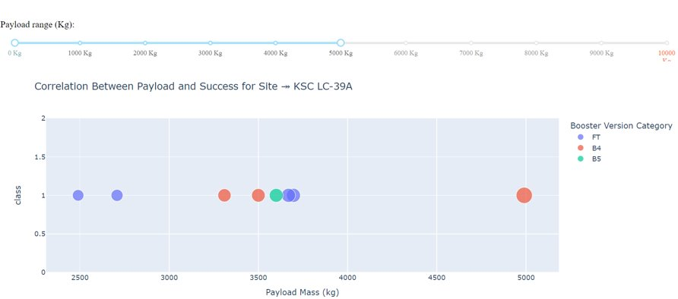
Payload Mass range for successful Launches

Slide 21
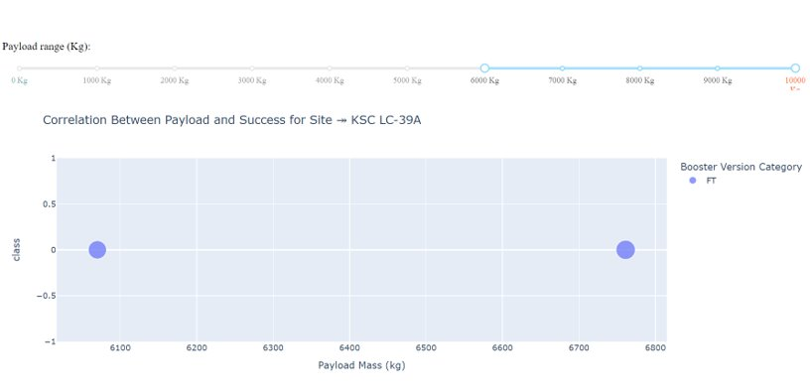
Payload range for unsuccessful lauches

Slide 22
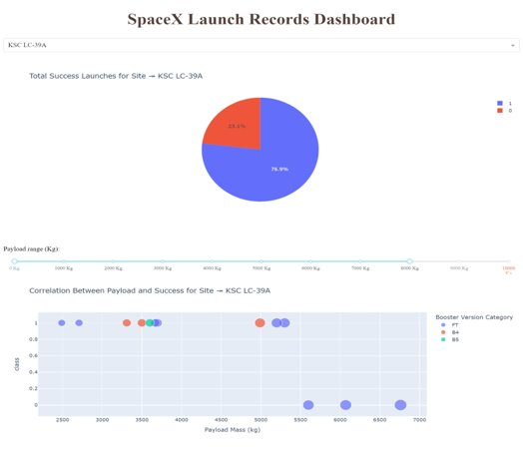
Payload Mass range
The highest success rate is from 0-5000
The lowest success rate is from 6000-10000
FT booster version has the highest score

Slide 23
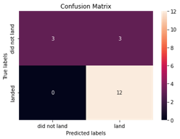
Predictive Analysis (Classification)
Used method to_numpy() to create an array from column Class.
We standardized data
We split the data into training and testing data using the function train_test_split
We only have 18 test samples
Created a logistic regression and a GridSearchCV object
The accuracy on the test data using the method score: 0.8333

Slide 24
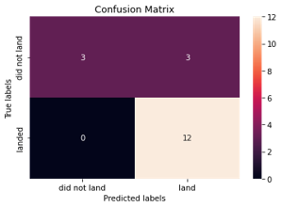
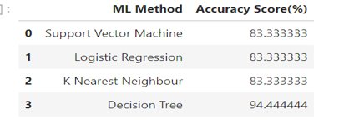
Predictive Analysis
Created a decision tree classifier object then create a GridSearchCV object tree_cv
The accuracy of tree_cv on the test data using the method score is 0.9444444
The method performs best is Decision Tree

Slide 25
Conclusions
The site with the highest score of landing successfully is KSC LC-39A
The highest success rate is for payload mass=[ 0-5000]
The rate of successful launch is correlated with flight number and payload mass.
The method performs best is Decision Tree with accuracy of 94%

Slide 26
Apendix
You can find all my notebook to this link:
Applied-Data-Science-Capstone/data wrangling eda.ipynb at main · Jorlina1/Applied-Data-Science-Capstone (github.com)

Slide 27


